Slide 1
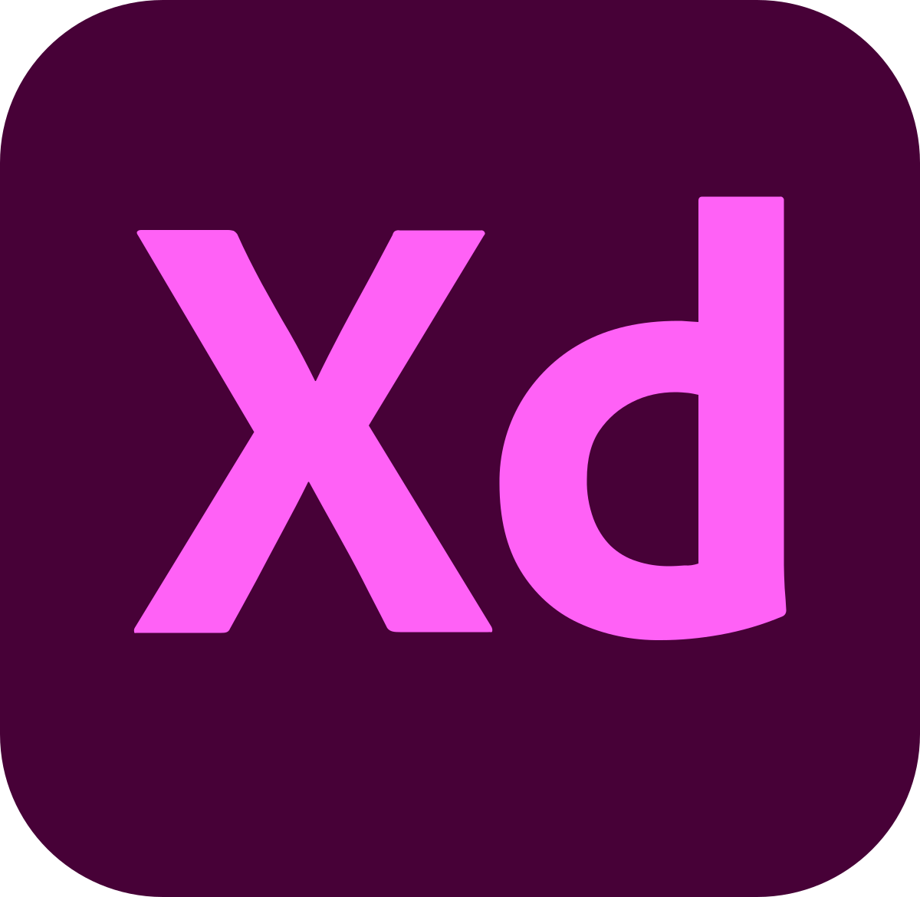
xd
XD is an emoticon commonly used to symbolize dying from laughter.
It represents 2 closed eyes with the X and mouth with the D.

